Slide 1
2026 Community Mental Health Survey
Trust Webinar 2
22nd June 2026

Slide 2
Agenda
Overview of 2026 Community Mental Health Survey (CMH26) [5 mins]
Sampling and contact approach [10 mins]
Instruction Manuals [10 mins]
Discussion of common queries and potential sampling errors [15 mins]
Questionnaire development: survey questions [10 mins]
Service-user facing materials [10 mins]
Data Protection and Section 251 requirements [5 mins]
Demographic Batch Service (DBS) checks [5 mins]
Entering Fieldwork [5 mins]
Key dates [5 mins]
Questions [5 mins]

Slide 3
Overview of 2026 Community Mental Health Survey (CMH26)

Slide 4
Overview of the 2026 Community Mental Health Survey
Run annually
Participation
Survey has run almost
every year since 2004.
50 Community Mental Health Trusts (CMHT) participate.
Mixed mode
Sample
Survey can be completed online, paper (postal), telephone.
Service users who attended CMHT during April and May 2026.
Accessibility
Eligibility
Survey available in Large Print, Braille, Easy Read, 10 different languages. BSL and can call interpreter for help in 19 languages.
Must be at least 16 years old to participate and had two contacts, one during sampling period and another during, before or after.
Notes:
The survey has run annually and has done so every year since 2004. Since 2023, it uses a mixed approach with completion online, paper or telephone. The survey is accessible in 10 different languages and is offered in large print, braille, easy ready and sign language. 50 trusts are participating with the sample made up of service users who attended a CMHT during April and May. They must be at least 16 years old and had two contacts – one during the sampling period and another during, before or after.

Slide 5
Sampling and contact approach

Slide 6
Sampling: criteria & boosted sample
Eligibility criteria:
  Aged 16 years and above; AND
  Was seen by someone face-to-face at the trust or via video conference (e.g. using Attend Anywhere, MS Teams, Zoom, etc.) or telephone call between 1st April and 31st May 2026 (the sampling period); AND
  Had at least one other contact (face-to-face, video conference, telephone, or email) either before, during or after the sampling period.
    As the sample is drawn in July 2026, we would expect there to be a large proportion of service users with a last contact date between April and June 2026.
Submission of a boosted sample:
  The sample size is a minimum of 1,250 service users; BUT
  Trusts are strongly encouraged to submit a boosted sample.
    Submission of additional sample records increases the possibility of reporting at a granular level.
    Benefits: Receive feedback from a larger number of service users, enabling reporting by assessment service group and reducing data suppression.

Slide 7
Sampling variables: changes since 2025
Community Treatment Order (CTO)
Coding of the Gender variable
New sampling variable for 2026
Simplified for 2026
  For 2026 survey, one variable has been added: ‘Community Treatment Order (CTO)’
  This means that any respondents in the sample who currently have or have had a CTO in place within the last 12 months can be recorded.
  The options will be ‘0= No, 1= Yes, and 2= Unknown’.
  The gender sample variable has been updated to align with the NHS Data Dictionary.
  Code 0 (not known) and code 8 (not specified) have been removed, and the naming of code 9 has changed from ‘Intermediate’ to ‘Indeterminate (unable to be classified as either male or female)’.
  The options will be: ‘1= Male, 2= Female, and 9= Indeterminate (unable to be classified as either male or female)’

Slide 8
Sampling: how to draw your sample
Confirm project team with the Survey Coordination Centre (SCC):
Display dissent posters:
Compile list of individuals:
Conduct DBS and local checks:
Submit sample declaration form (SDF):
Submit sample file
Set up a project team comprising a Survey Lead, person who is drawing the sample and your Caldicott Guardian.
Inform the SCC.
S251 requirement.
Display throughout April & May 2026.
Follow the Sampling Instructions to create your sample.
Once your sample has been drawn, it must be locally checked for deceased service users and submitted for DBS checks.
Must be submitted to your contractor and signed off by them before you can submit your sample file.
Submit to your contractor via a secure encrypted link.
Please be available to answer queries:
Both your contractor and SCC will review your SDF before it is signed off. They may have queries, and a timely response is crucial for preventing delays in entering fieldwork.
Key document: Sampling Instructions

Slide 9
Contact approach
Contact | Type | Content of contact | Days from first mailing | Example of mailing days
1.0 | Postal | Invitation letter with URL and QR code for online survey. Multilanguage sheet with QR codes. | 0 | Monday 17 August
1.1 | SMS | SMS reminder (if phone number available). | 7 (5 working days after contact 1.0) | Monday 24 August
2.0 | Postal | Reminder letter with URL and QR code for online survey. Paper Questionnaire. Freepost return envelope. Multilanguage sheet with QR codes. | 14 (10 working days after contact 1.0) | Tuesday 01 September: pushed to Tuesday as Monday falls on a bank holiday (31st August)
2.1 | SMS | SMS reminder (if phone number available). | 21 (5 working days after contact 2.0) | Tuesday 08 September
3.0 | Postal | Reminder letter with URL and QR code for online survey. Paper Questionnaire. Freepost return envelope. Multilanguage sheet with QR codes. | 28 (10 working days after contact 2.0) | Tuesday 15 September
Please ensure that DBS and local checks are provided in plenty of time to allow mailings to be sent on time.
Trusts will need to work alongside their approved contractors to agree on dates to complete these checks before the start of fieldwork. DBS and local checks will be covered in additional detail later in the presentation.

Slide 10
Instruction manuals

Slide 11

Survey handbook
For survey leads:
  Document outlining step-by-step process for preparing and running the survey.
  It is a key summary document that links to all other relevant information regarding the survey handbook.
Includes:
  What’s new for CMH26.
  Tips on managing and implementing the survey.
  Key dates: top level.
  Highlights on key information e.g. Section 251.
This document is now available on the NHS Community Mental Health website .

Slide 12

Sampling instructions
For sample drawers (data team):
  Document outlining step-by-step process of how to draw your sample.
  Key summary document that links to all other relevant information regarding survey sampling.
Includes:
  Overview of the sample drawing process.
  Details on eligible and ineligible service users.
  Information on DBS checks for deceased service users. This has been updated for 2026 and will be outlined later in the presentation.
  Checking and submitting your sample.
This document is now available on the NHS Community Mental Health website.

Slide 13
Other Documents
Sample Construction Spreadsheet
Sample Declaration Form
To be used to construct the sample of eligible service users for the survey.
  Includes all relevant fields for the sample details, mailing details and fieldwork variables.
To be used to check your sample has been correctly drawn before submission to your contractor or the SCC.
  Includes – instructions, checklist, declaration agreement.
  Must be signed by the sample drawer AND your Caldicott Guardian prior to submission.
These documents are available on the NHS Community Mental Health website.

Slide 14
Sample Declaration Form
Completing the Sample Declaration Form can help avoid errors when drawing your sample. Avoiding errors will ensure your questionnaires can be mailed out earlier and your data will be usable in this year’s survey. This includes:
Sample Figures.
Checklist (with list of Sub-ICB codes)
Declaration Agreement: to be signed by person drawing sample and Caldicott Guardian
The form is available on the NHS Community Mental Health website.

Slide 15
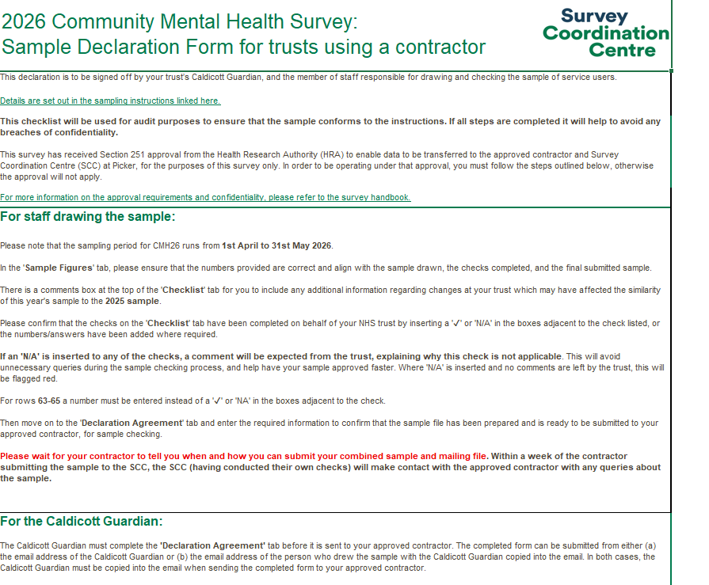
Sample Declaration Form: ‘Instructions’ tab
  ‘Instructions’ tab
    This includes information on how to complete the declaration form correctly. It’s recommended that this is reviewed ahead of completing the form.
    Please ensure that your Caldicott Guardian also reads this tab.

Slide 16
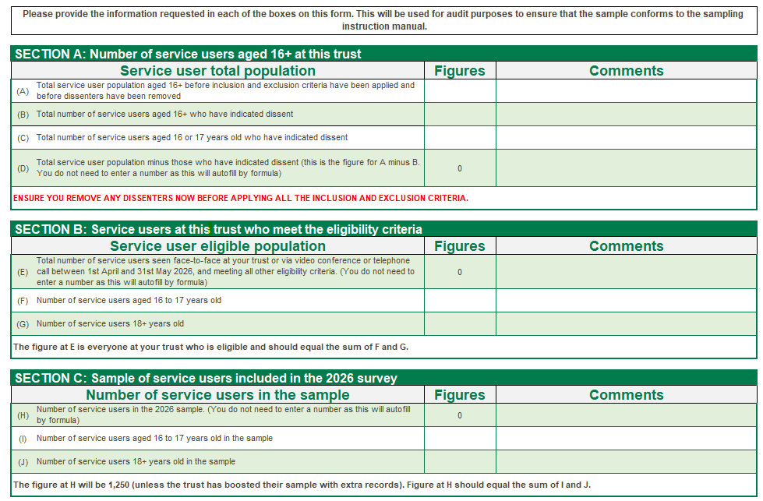
Sample Declaration Form: ‘Sample Figures’ tab
  ‘Sample Figures’ tab
    For Section A, please provide a figure for checks A, B and C. Check D will automatically populate.
    For Section B, please provide a figure for checks F and G. Check E will automatically populate.
    For Section C, please provide a figure for checks I and J. Check H will automatically populate.
      If you have submitted a boosted sample, please record this in the ‘Comments’ section for check H.
    Make sure to follow any red instructional text.
    Missing information can cause delays to the approval of your sample.
    If there are checks where you are unsure what information is required, please consult your approved contractor or the SCC team.
In the ‘Comments’ column, please add any information which may help explain differences in sample figures from previous years. For example, where there has been a change within the trust, which has affected services.

Slide 17
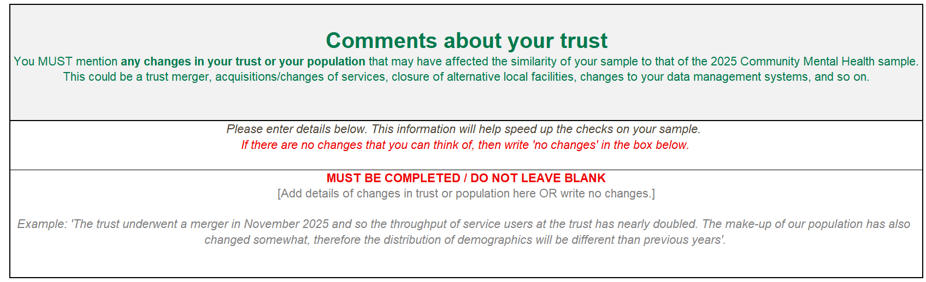
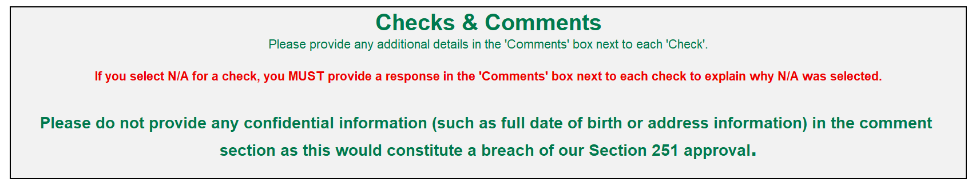
Sample Declaration Form: ‘Checklist’ tab (1)
  ‘Checklist’ tab
    The “Comments about your trust” section MUST be completed – if there are no changes in your trust this year that could affect the comparability of your sample to last year e.g. trust merger, acquisitions / changes of services etc, then you can write “No changes” in this section. Do not leave this section blank.
    All checks must be completed – if you have added “N/A” for a check, the “Comments” column MUST be completed. Missing information can cause delays to the approval of your sample.
    If there are checks where you are unsure what information is required, please consult your approved contractor or the SCC team.

Slide 18
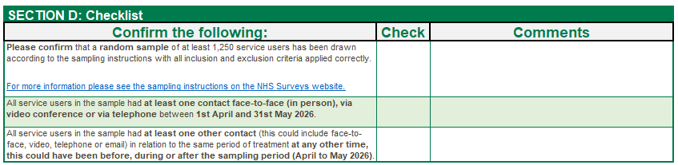
Sample Declaration Form: ‘Checklist’ tab (2)
  ‘Checklist’ tab
    Make sure to complete dropdown for the ‘Check’ column for each row.
    If you answer ‘N/A’ to any of the checks, please add details into the ‘Comments’ cell so that we can understand the rationale.
    We will query any shifts of >5% since 2025. This is to ensure that the sample characteristics haven’t changed significantly from the previous year - significant changes in sample characteristics may affect benchmarking and your trust’s comparability to previous years.

Slide 19
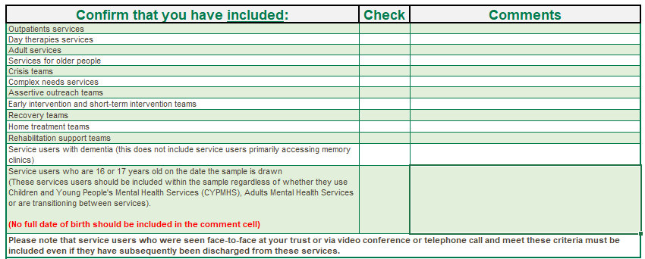
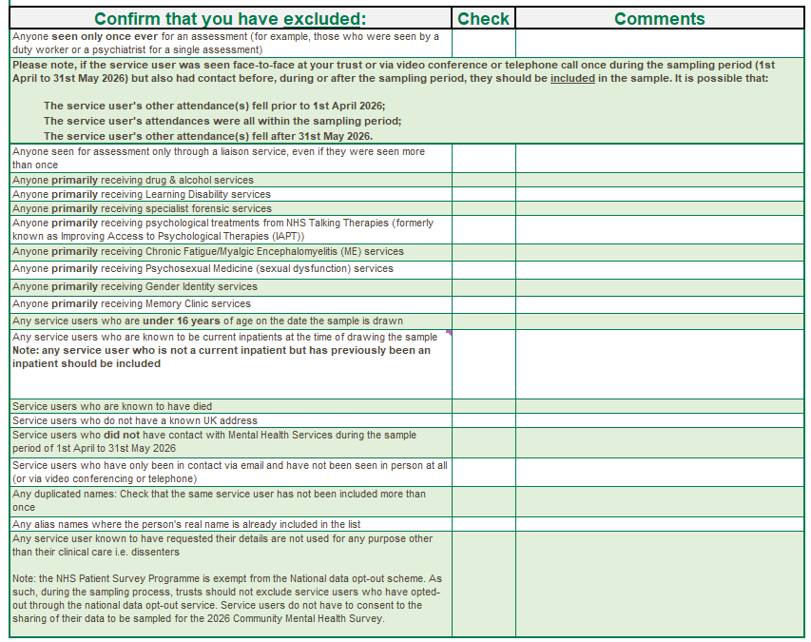
Sample Declaration Form: ‘Checklist’ tab (3)
  ‘Checklist’ tab
    Make sure to follow any additional instructions provided.

Slide 20
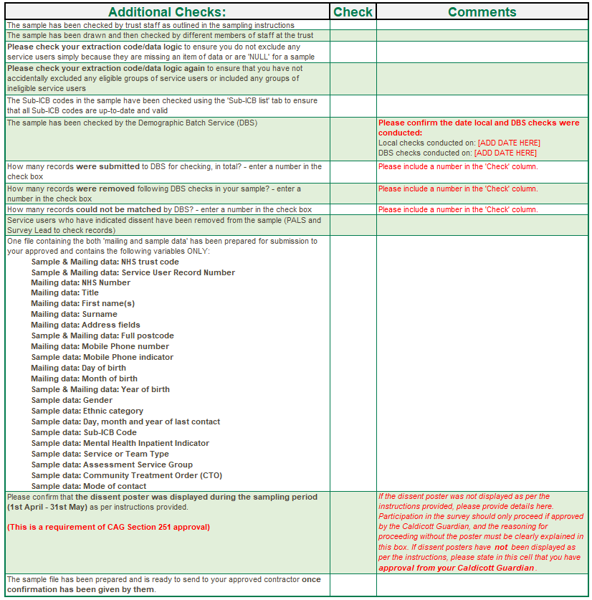
Sample Declaration Form: ‘Checklist’ tab (4)
  ‘Checklist’ tab
    Please provide dates when the local checks and DBS checks were conducted.
    There is a new check for 2026, which asks you to confirm that the dissent poster was displayed for at least the minimum time period (April – May 2026). If the poster was not displayed during this timeframe, details of why, along with approval for this from your Caldicott Guardian must be added to the ‘Comments’ cell.

Slide 21
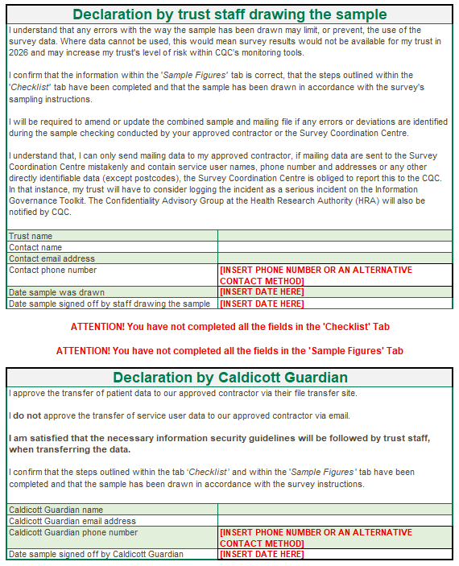
Sample Declaration Form: ‘Declaration agreement’ tab
  ‘Declaration Agreement’ tab
    This must be completed and signed by BOTH the individual who has drawn the sample for your trust AND your Caldicott Guardian.
    The date the sample has been signed off by both individuals, along with email addresses and contact numbers must also be added.
    Missing information can delay the approval of your sample.
  Make sure to enter a contact number or explain an alternative contact method e.g. “I don’t have a phone number, please use email”.

Slide 22
Sample Declaration Form: Submission
Submitting your Sample Declaration Form:
Sample declaration forms are to be submitted to your approved contractor.
Once the form has been approved, please submit your sample safely via the secure file transfer site.
Tips
Take care to fill in dates.
Schedule time for sign-off in advance with Caldicott Guardian.
SCC will query any unexplained shifts of >5% in your sample, so it’s best to provide as much detail about any changes since 2025 as you can.

Slide 23
Discussion of common queries and potential sampling errors

Slide 24
Check sample prior to submission
Examples of checks you should do before submitting your sample:
Check that the eligibility criteria have been correctly applied – ensure the sample includes service users who have had at least one contact that is in person, via video conferencing or by telephone during the sampling period (this could include an initial assessment) AND had at least one other contact (face-to-face, video conference, telephone, or email) either before, during or after the sampling period.
Check last contact date – the last date the service user had contact with NHS community mental health services, during or after the sampling period (April to May 2026). As the sample is drawn in July 2026, we would expect there to be a large proportion of service users with a last contact date between April and June 2026.
Check you included 16- and 17-year-olds in your sample.
Ensure service users on the national data opt-out programme are not excluded.
Ensure service users who have dissented to taking part are excluded.
Ensure you have not excluded an eligible service user group.
Are there any errors in the query used to extract the eligible population?
Are there any missing / incomplete data in your initial database?

Slide 25
Check sample prior to submission: continued
Examples of checks you should do before submitting your sample:
Ensure there is no incomplete address data - all records should have enough postal information to ensure the letter would be successfully delivered, and ensure valid correct postcodes are included when available.
Check all codes provided in your sample are valid.
Make sure local and DBS checks are undertaken by the trust. There is a new process for 2026:
  Once you draw your sample of eligible service users, this list must be locally checked for deceased service users, and it must be submitted for DBS checks. This is to check for any service users who may have died since they used services at your trust.
  Once a sample has been approved for fieldwork, if it has been more than two weeks since the trust’s initial checks were conducted, a further DBS check and / or a local check must be completed before the first mailing. It is not necessary to do both, but at least one must be conducted.
  After you have completed checks on the initial sample, upon agreement with the trust, the approved contractor can conduct DBS checks on your behalf – this includes DBS checks prior to the first mailing and between mailings. Local checks are optional at this stage but should be discussed and agreed with the trust.
Check Sub – ICB code is correct and matches ODS document (as updated in July 2022).
Check the mobile phone number is correct – no landline numbers are included; check there are 11 digits in each number.
  It is really important that we have as many mobile phone numbers available in the sample as possible, and that these details are accurate. This enables text message reminders to be sent to respondents between mailings, helping to encourage participation and support our aim of increasing the survey response rate.
Be aware of system migrations, as they can lead to downtime which can delay drawing your sample or introduce significant shifts in the demographic proportions compared to the previous survey year.
Make sure you have randomly sampled.
Check there are no filters on columns before drawing the sample.
.
Notes:
If a service user has part of their address missing, they shouldn’t be removed, as long as there is enough postal information to ensure letter can be successfully delivered.

Slide 26
Discussion of common trust queries
Can my trust still participate even though we can’t reach the minimum sample size? Yes, although you may not receive full results, we would still encourage you to take part. Please let SCC and your contractor know if your sample will be less than 1250.
Do we need to wait until 1st July to collect the data for our sample? No, as long as the eligibility criteria has been followed to produce your sample.
How should we categorise cases where two or more service types have been used equally? Where multiple service types have been used an equal number of times, you are advised to categorise the case according to the most recent service the user had contact with.
How should we categorise cases where a different service type was primarily used during the sampling period? You are advised to categorise these cases according to the service user’s age group:
  1 = Child and Young People’s Mental Health Services (16-18 years old)
  2 = Adult Mental Health Services (19-65 years old)
  3 = Older People’s Mental Health Services (over 65 years old)

Slide 27
Questionnaire development: survey questions

Slide 28
Development process
February - April 2026
May - June 2026
July – August 2026
Engagement Trust Webinar: to discuss with trusts the usability and approach taken with the 2025 promotional materials to try and increase response rate for 2026.
Stakeholder consultations: to understand service user populations and what mechanisms stakeholders use to engage with service users.
In-depth interviews with service users: to understand what encourages service users to complete a questionnaire, their preferred method of contact, survey mode and channels to promote a survey. Approaches to improve the cover letters and make them more motivational were discussed in-depth.
Advisory group: to understand stakeholder priorities regarding community mental health, and current policy, taking into account all feedback collected so far.
Cognitive interviews: 90-minute virtual interviews with 24 x service users from various demographic backgrounds who had recently used community mental health services. These interviews focused on perceptions and understanding of the cover letters and online and paper surveys.
Second Trust Webinar: to discuss sampling process and questionnaire amendments for 2026.
Questionnaire finalised: at the end of June.
Online survey finalised in July.
Trusts should draw their samples during July, as fieldwork begins in August. This is to avoid any delays to fieldwork.
Full details will be available in the Survey Development Report

Slide 29
New questions for CMH26
Question | Rationale
Online question x2: Please tell us about your experiences of moving, or preparing to move, from Children and Young People’s services to Adult services. This may include information, support and care that you have received, or anything else important to you. | The free-text question has been added to replace the closed questions, allowing service users to share feedback on what they consider important and describe their experiences in their own words. This will enable free text comments to be reviewed without suppression thresholds in place.
The following questions ask about discrimination. This means being treated unfairly because of who you are or who people think you are. These questions can feel sensitive, and you can skip them if you prefer. For support, you can visit Mind: mind.org.uk/need-urgent-help/using-this-tool Q36: Did you feel your NHS mental health team discriminated against you? | New questions on experiences of discrimination have been added to capture whether service users were discriminated against by the NHS mental health staff, and if so, what type of discrimination they experienced. Stakeholders agreed that discrimination is an important experience to measure for mental health service users, and that the survey is an appropriate tool to do so, provided that the questions are carefully worded and supported by clear signposting.
Q37: What do you think or feel this was related to? Please cross ✗ in ALL the boxes that apply to you.

Slide 30
Amended questions for CMH26
Question | Rationale
Q42: Do you have any of the following physical or mental health conditions, disabilities or illnesses that have lasted or are expected to last 12 months or more? | A new response option, ‘Neurodivergence (other than autism or autism condition) has been added to the question. This has already been applied to other surveys in the NPSP to improve inclusivity, as the option of ‘autism’ was too narrow.
Q45: At birth were you assigned as… | In response to the Supreme Court ruling: “For Women Scotland (appellant) v The Scottish Ministers (respondent)”, the option of ‘intersex’ was removed. This also follows changes already applied to other surveys within the NPSP.

Slide 31
Questions removed for CMH26
Question | Rationale
Q13: Did your mental health team tell you who to contact if you had any questions or concerns about your care or treatment? | Concerns were raised that respondents may interpret the question broadly and think about a range of contacts, including GPs and Care Quality Commission (CQC), rather than a named contact within the mental health team. Stakeholders outlined the importance of service users having a 'named’ contact; however, this is only specified as a requirement in NICE guidelines in crisis care planning.
Q19: Have you been given a diagnosis for your mental health? | Stakeholders agreed the question was less actionable and of lower priority. Feedback suggested that diagnosis alone does not reliably reflect the quality of care or service user experience. Diagnosis can take a long time due to complex presentations, the need for assessment over time, service pressures and clinical caution. This delay was already reflected in the existing data, which showed that the proportion of people reporting having received a diagnosis increased the longer they had been in contact with services.
Q25: Thinking about the last time you received therapy, did you have enough privacy to talk comfortably? | Stakeholders agreed that the privacy question had limited value and showed strong ceiling effects. Privacy can be outside of a trust’s control due to different delivery methods available (e.g. video call in the person’s home).
X6: In the last 12 months, have you had a Community Treatment Order (CTO) in place? | An online only question, which was removed due to the addition of the new sampling variable which records whether service users have had a CTO.

Slide 32
Service-user facing materials

Slide 33
Service-user facing materials
Multilanguage sheets
Minor changes were implemented for these documents in 2026.
The sheet offers 19 non-English langauges. Nine of these have a QR code which links straight to the survey in that language. French has been replaced by Romanian as an online survey option, but French has been retained for translation support via an interpreter in place of Thai. Service users whose first language is not English would read the sheet in their preferred language where available.
Covering letters
Accessibility options more prominent. Format changes to make key messages more prominent. Wording simplified and shortened where possible. Tone made to be friendlier and warmer.
SMS guidance
Posters: Dissent &
16/17 year olds’ leaflet
Reference to ‘survey ID’ updated to be ‘survey number’, and opt out text updated for consistency across the NPSP.
Minor text and formatting changes made to the dissent poster and the 16/17-year olds’ leaflet.
Notes:
The change in languages is following a review of the most commonly spoken languages in England and the survey languages have been updated to reflect this.

Slide 34
Cover letter changes
To increase engagement with the survey, a key focus during the development of CMH26 has been to improve how motivating and encouraging the cover letters are. Stakeholders suggested ways to improve the cover letters, including altering the design and making the wording more motivating and eye-catching. The following changes have been implemented to the 2026 covering letters:
Accessibility options have been made more prominent and are now signposted in bold text at the beginning of the letter.
Formatting has been reviewed to include bullet points of key messages about the survey, such as confidentiality, legitimacy of the letter and importance of responding. This is to make the key information more prominent.
Wording around carer support being acceptable has been emphasised.
Wording has been simplified and slight amends made where possible and made more motivational to help prioritise key messages, and to reduce length and remove unnecessary detail.
Warmer, friendlier, welcoming and less formal tone.
Clearer structure with more headings and white space so the letter can be more easily read at a glance.
Icons added to second page to break up the text and improve readability.

Slide 35
Other survey materials: publicity
Press Release Template
Social Media Cards
Website Banner
Outlines the purpose and value of survey for trusts.
Applies “You said, We Did” principles to demonstrate how service user feedback has been implemented.
Can be tailored to demonstrate how research findings have been used to identify areas of improvements and action change.
Provides information about the purpose, value and dates of the survey.
Includes: 1x call to action, 1x reminder pre-fieldwork and 3x reminders during fieldwork.
Can be shared by trusts and national organisations on social media platforms like Facebook or LinkedIn or printed to use as leaflets.
Highlights the message of helping to improve community mental health services by completing the survey.
Includes: 3x simple banners.
Banners can be added to websites, email signatures and any other platforms as appropriate.

Slide 36
Publicising the survey: why is it important?
Encourages service users to participate
  Increased representation within the data
  Provides service users with a voice and opportunities to share their feedback with trusts
  Helps to maintain / increase response rate
Increases cases for analysis
  Further analysis of questions at trust level and by Assessment Service Group (ASG)
  Sub-group analysis
  Reduces the possibility of suppression
For further information:
  https://nhssurveys.org/survey-instructions/publicising-surveys/

Slide 37
Publicity toolkit timetable
Below is the schedule for which publicity materials should be utilised to encourage engagement with the CMH26 survey before, during and after fieldwork.
Publicity materials (including dissent posters) can be accessed from the “Survey Materials” section of the NHS patient surveys website.
Activity | Date
Share Press Release template | April – July 2026
Display dissent posters | Throughout April & May 2026
Share 16-17 year olds leaflet | April – July 2026
Share Social media card 1 | April – July 2026 Re-share: Mid-late August 2026
Use Website banner | August – November 2026
Share social media cards 2 & 3 | April – July 2026 Re-share: September – November 2026
Share social media card 4 | April – July 2026 Re-share: September – November 2026

Slide 38
Accessibility options
As per previous iterations of the Community Mental Health Survey, there are a variety of accessibility features available for the online survey and paper questionnaire to ensure all service users can complete the survey in line with their individual needs.
Via online survey
A A
Change font size
Change background colour
Screen reader compatible
Multiple language options
British Sign Language
  Large-print questionnaires
  Easy Read
  Braille
  Language line: option to contact a telephone-assisted helpline to request help to complete the survey. Help is available in 19 languages.
Via contractors on request

Slide 39
Data Protection and Section 251 Requirements

Slide 40
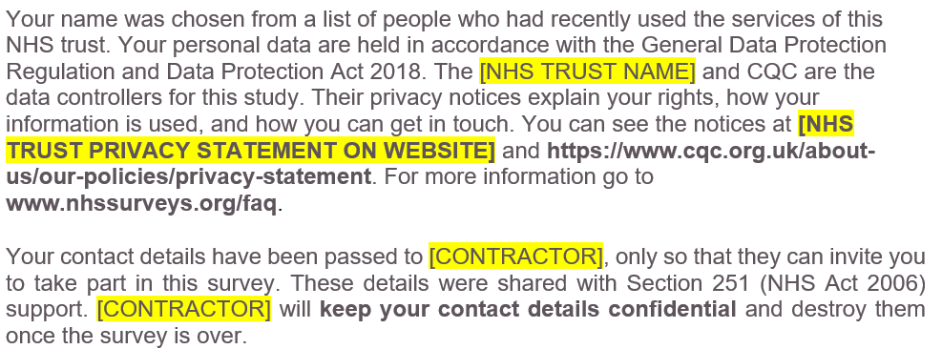
General Data Protection Regulation (GDPR) & National Data
Opt-Out Programme
National Data Opt-Out Programme
General data protection regulation (GDPR)
NPSP has received exemption from the National Data Opt-out Programme.
  How service users’ personal data is being protected under the GDPR is stated on the reverse side of the covering letter for mailings 1-3:
We will continue to have separate opt-out mechanisms via the dissent posters that need to be displayed across all trusts.
Please note that service users do not have to actively consent to the sharing of their data, for the CMH26 Survey.

Slide 41
Section 251 requirements
  We ask you to publicise the survey both internally and externally to ensure service users are aware of the survey and have the opportunity to opt-out should they wish. Example materials are available in the 'Publicising the survey’ document.
  You can also use the publicity materials we have provided you with.
  Ensure a log of service users who have dissented from taking part in the survey is accurately kept.
  Ensure the total number of eligible service users who have dissented from the sharing of their details for any purpose other than their clinical care or who have dissented from taking part in the survey specifically are recorded in your sample declaration form and are excluded from your sample.
  Section 251 allows service user data to be shared outside of NHS trusts without gaining prior and explicit consent from these service users. In order for their contact data to be shared without consent to a third party, you have to display the dissent poster and provide 16/17-year-old service users with a leaflet.

Slide 42

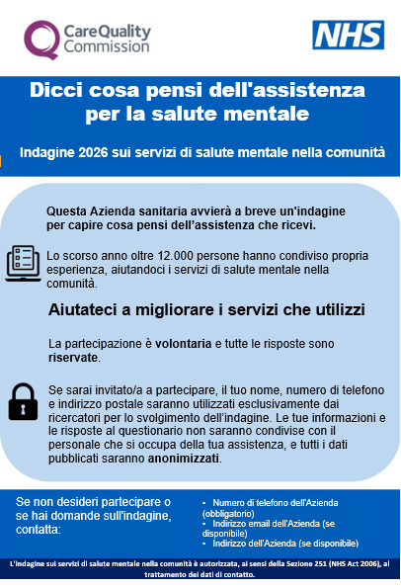
Section 251 requirements: dissent poster and 16/17-year-olds leaflet
  Dissent posters give service users the opportunity to opt-out (available on the NHS Surveys website).
  Posters MUST be displayed during the sampling months (April & May 2026) to comply with Section 251 requirements.
  Posters are available in English, and have been translated into the 12 most commonly spoken languages in England as well as languages requested by trusts. There are 12 translations available:
    Arabic, Bengali, Gujarati, Indian Punjabi, Italian, Kurdish Sorani, Polish, Portuguese, Romanian, Spanish, Ukrainian and Urdu
The 16/17-year-olds leaflet should be shared with service users throughout the sampling months (and preferably until the end of the sampling period) on your trust’s website, in or around the trust (e.g. on noticeboards) and be handed out to service users when they attend appointments.

Slide 43
Demographic Batch Service (DBS) Checks

Slide 44
DBS checks
  A change has been made to the process of conducting DBS and local checks for the CMH26 Survey.
  What has changed:
    DBS and local checks were previously required if it had been more than 2 weeks (10 working days) between the time of the sample being drawn and the first mailing. This has now been adjusted to offer greater flexibility to trusts and contractors.
    Going forwards, trusts will have the choice to conduct a DBS check and / or a local check if it has been more than 2 weeks between the time of the sample being drawn and the first mailing being sent. One of these checks MUST be done but both are not necessary.
    Trusts and contractors will need to discuss and agree which checks will be conducted (both or just one) and who will be responsible for conducting the checks.
  What remains the same:
    First checks are completed when the initial samples are drawn by the trusts. Trusts must conduct both a DBS check AND a local check on the initial sample of 1,250 service users.
    After first checks, and upon agreement with the trust, contractors can conduct DBS checks on trusts’ behalf; this includes DBS checks prior to the first mailing and in between each mailing.
    DBS and / or local checks must be run prior to the second mailing and third mailing to avoid sending reminders to service users who have died in between mailings.
Drawing sample
DBS check required
Local check required
Mailing 1
If >2 weeks has passed since first checks made:
DBS check and / or local check
Mailing 2
DBS check and / or local check
Mailing 3
DBS check and / or local check

Slide 45
Generic NPSP Instruction Documents
Other instructional documents that are useful for implementing the 2026 Community Mental Health Survey can be found on the NHS Surveys website:
Patient feedback and the NHS Constitution
Setting up a project team
Data protection and confidentiality
Ethical issues, ethical committees and research governance
Collecting data from non-English speaking populations
Publicising the survey
Implementing the survey – practicalities
Submitting samples
Entering and submitting final data
Making sense of the data
Reporting results
Universal glossary
Updated trust-level benchmark reports

Slide 46
Entering fieldwork

Slide 47
Entering fieldwork early / on time
Entering fieldwork on time or earlier will help your trust to maximise responses rates, providing your trust with more data.
Ensure you have a survey team in place before you start drawing your sample.
Generate your sample promptly - begin preparing now.
Respond to queries as soon as possible to avoid unnecessary delays.
Ensure there is sufficient resourcing around the time of drawing your sample and answering queries – communicate with your team, handover tasks if people are going to be on leave and let your contractor and the SCC know any updates.
If there are any changes in the survey lead, inform your contractor and the Survey Coordination Centre (SCC).

Slide 48
Key dates

Slide 49
Key dates - Overview
Activity | Date
Dissent posters published on website | March 2026
Dissent posters to be displayed | Throughout April – May 2026
Section 251 approval | Early June 2026
Publication of sampling materials (following section 251 approval) | 15 June 2026
Publication of service user-facing materials (following section 251 approval) | 24 June 2026
Start drawing your sample | 1 July 2026
Submit sample to contractor | Contractor to confirm
SCC check samples | 20 July – 07 August 2026
Fieldwork | 17 August – 27 November 2026
Trusts receive local results | Contractor to confirm
Publication date (Spring 2027) will be announced here: https://www.cqc.org.uk/publications/surveys/nhs-patient-survey-programme-outline-programme-publication-dates

Slide 50
Questions

Slide 51
Thank you for your time
A copy of the slides will be on the NHS Surveys website
Contact us:
mentalhealth@surveycoordination.com
01865 208127
Project Team (SCC):
Samantha Guymer (Research Manager), Chrysa Lamprinakou (Senior Research Associate), Catherine Davidson (Research Associate).

